Slide 1
MambaIC: State Space Models for High-Performance Learned Image Compression

Slide 2
Outline
Introduction and Motivation
Background and Architecture
Unique Components and Experimental Validation

Slide 3
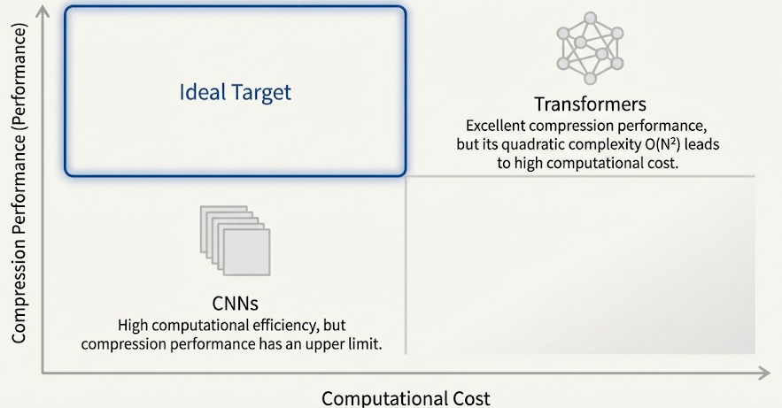
The Need for Image Compression
High-resolution images are growing rapidly, making compression essential for storage and real-time transmission. Traditional formats (JPEG, BPG, VVC) and modern deep-learning methods (CNN, Transformer-based LIC) exist, but there is still room for improvement.

Slide 4
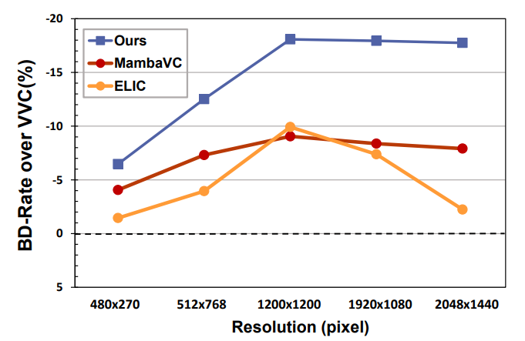
Motivation : Computational Bottlenecks
Even top-performing learned compression models suffer from heavy computation. Transformers in particular have quadratic complexity, meaning they become very slow for high-resolution images. This limits real-world use.

Slide 5
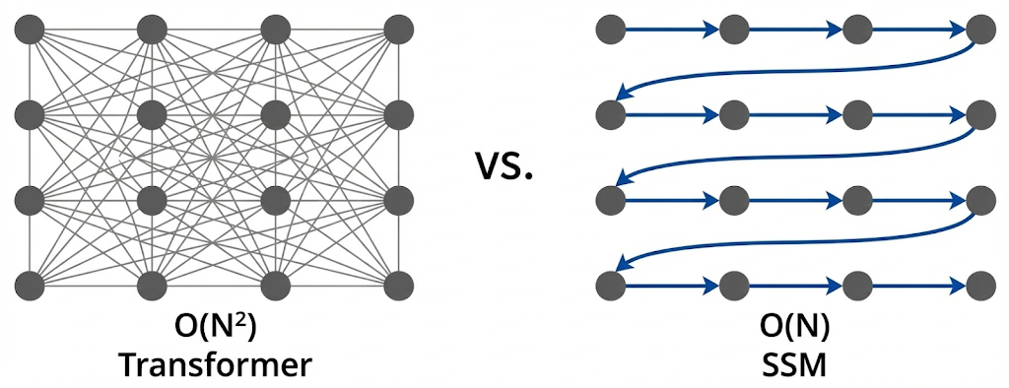
Motivation : The SSM Solution
SSMs process long sequences efficiently in linear time and are hardware-friendly. MambaIC’s idea: use SSMs to reduce computation while keeping strong global dependency modeling, aiming for a better efficiency–performance trade-off.

Slide 6
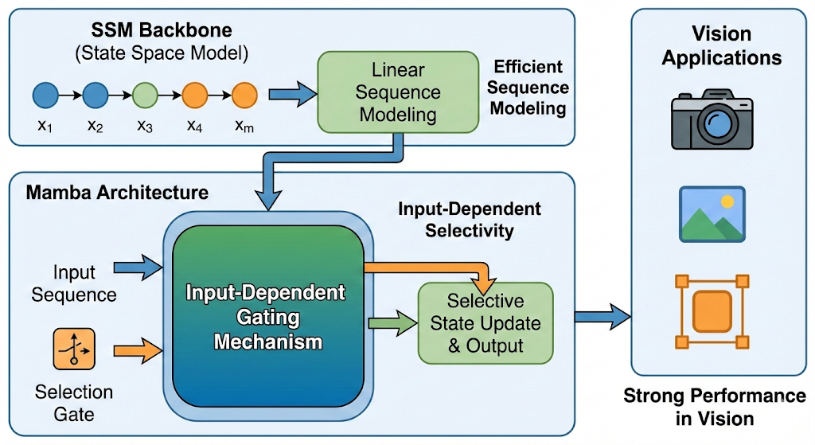
Understanding State Space Models (SSMs)
SSMs model sequences efficiently. The Mamba architecture further improves SSMs by adding input-dependent gating. Mamba-based models already show strong results in vision tasks.

Slide 7
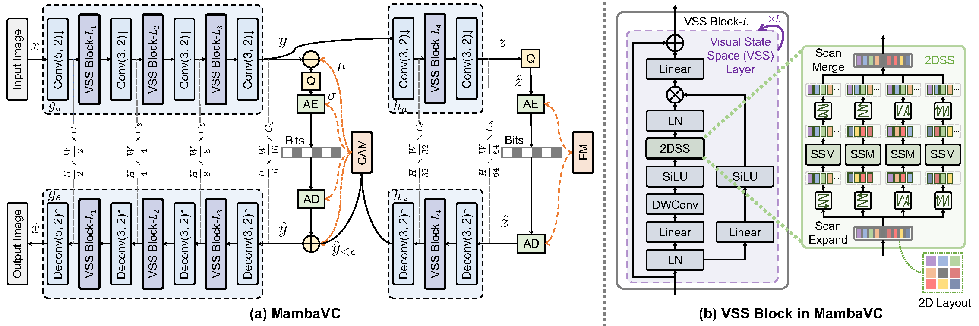
Limitations of Prior SSM Attempts (MambaVC)
Earlier work like MambaVC tried using SSMs for compression but only replaced blocks without adjusting the architecture. As a result, its performance was limited. This shows that careful SSM integration is necessary—what MambaIC provides.

Slide 8
MambaIC Overall Architecture
MambaIC is the first to integrate SSMs in both the nonlinear transform (encoder/decoder) and the context entropy model. The system includes:
SSM-based analysis (gₐ) and synthesis (gₛ)
An SSM-enhanced context model predicting μ and σ for entropy coding

Slide 9
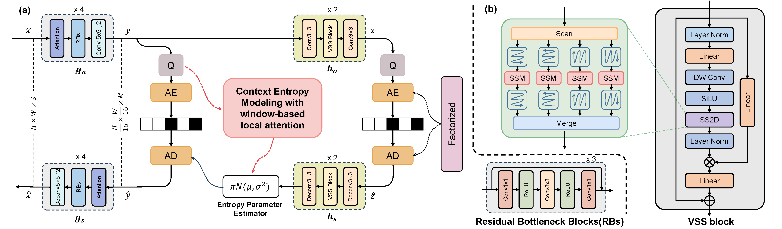
MambaIC Overall Architecture

Slide 10
The Visual State Space (VSS) Block
The VSS block uses a 2D selective scan (SS2D): it scans the feature map in four directions, processes each with an SSM, and merges the results. This gives a strong global receptive field while staying efficient.

Slide 11
Hybrid Channel-Spatial Context Modeling
MambaIC combines:
Channel autoregressive modeling (previous latent channels)
Spatial contexts (neighboring decoded positions)
VSS blocks help both parts, giving richer side information for entropy estimation.

Slide 12
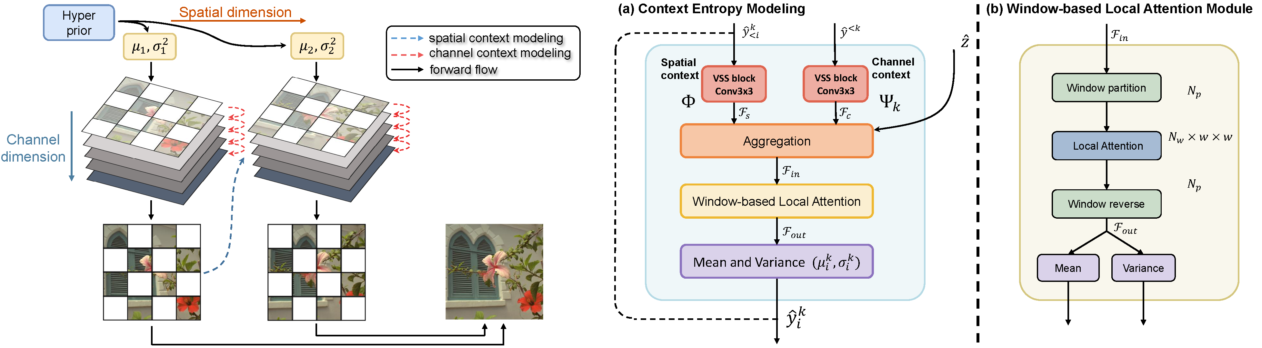
Hybrid Channel-Spatial Context Modeling

Slide 13
Window-Based Local Attention (WLA)
VSS captures global information, but WLA improves local relationships. Using window partitioning, it keeps attention efficient and reduces remaining spatial redundancy.

Slide 14
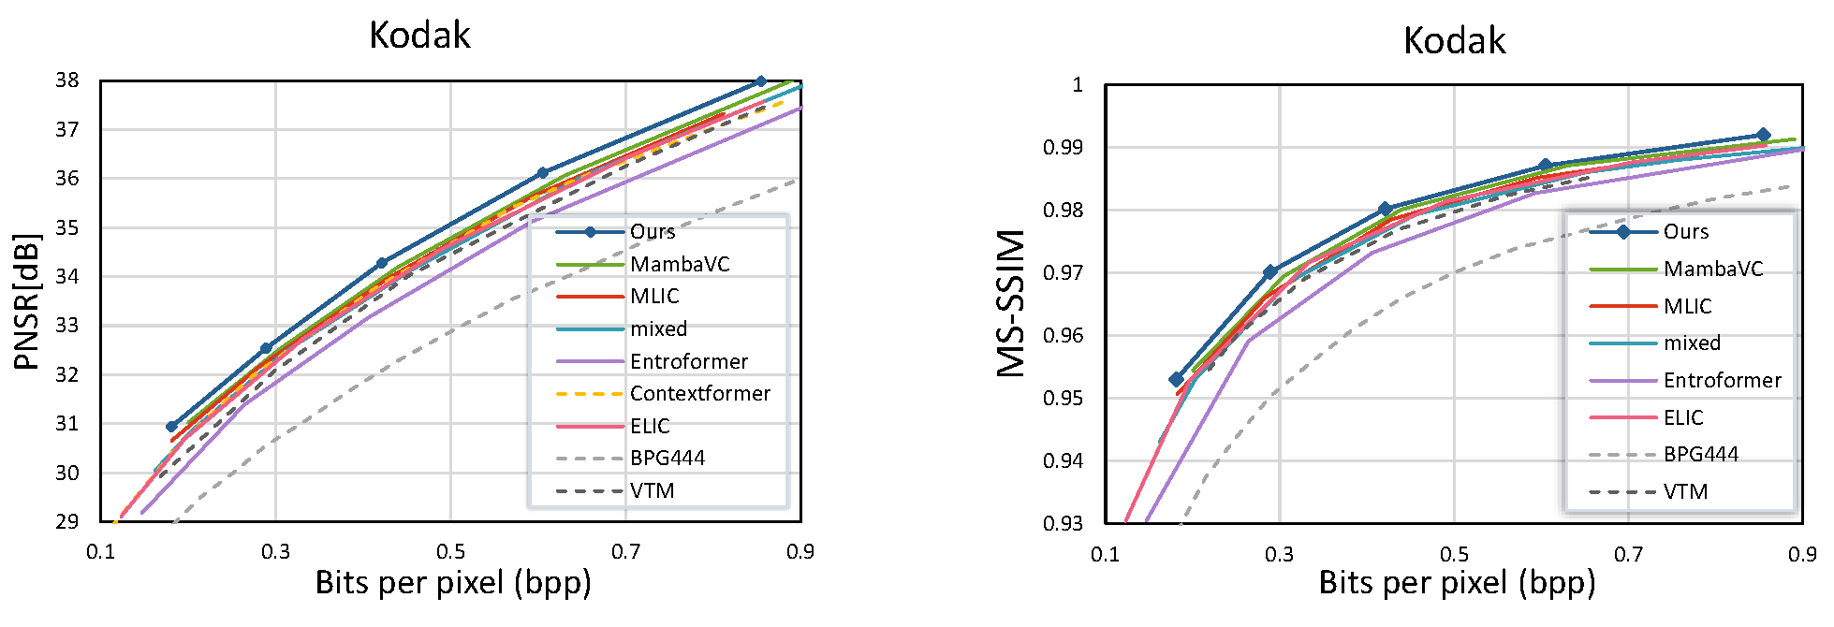
Performance on Standard Datasets (Kodak)
On the Kodak dataset, MambaIC achieves the best rate-distortion performance (PSNR & MS-SSIM). It clearly outperforms both classical codecs and previous SSM-based designs like MambaVC.

Slide 15
Performance on Standard Datasets (Kodak)

Slide 16
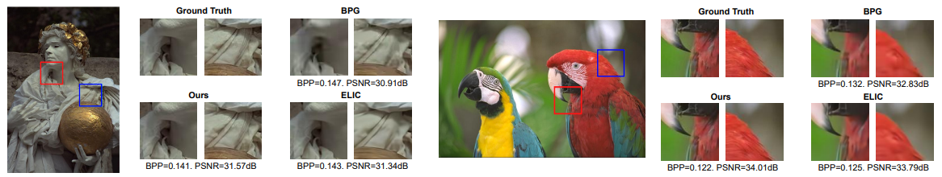
Performance on Standard Datasets (Kodak)

Slide 17
Superior Scaling to High Resolution
On high-resolution datasets (Tecnick, CLIC), MambaIC remains stable and competitive. Its performance advantage increases as resolution becomes higher—showing SSMs handle large images very well.

Slide 18
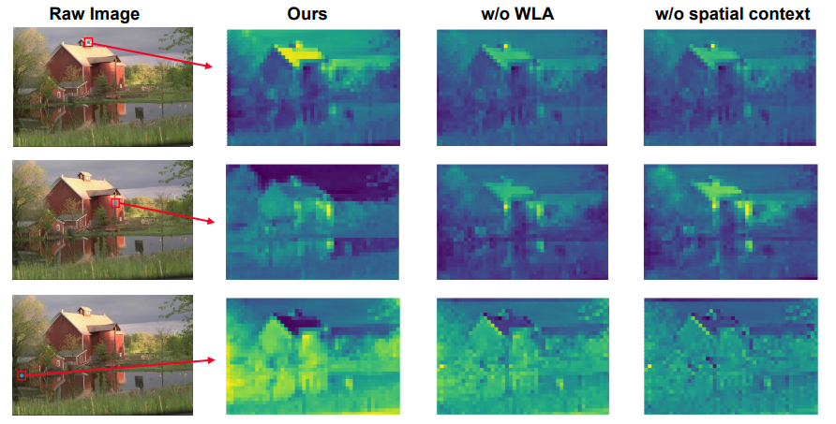
Superior Scaling to High Resolution

Slide 19
Quantitative BD-Rate Comparison
MambaIC achieves −12.52% BD-Rate over VVC on Kodak (PSNR), far better than ELIC (−3.95%) and MambaVC (−7.31%). This proves the strength of the design.

Slide 20
Inference Efficiency (Decoding Speed)
MambaIC decodes faster than other high-performing methods.
MambaIC: 39.42 ms
ELIC: 45.34 ms
Transformer-hybrid models: 91.44 ms MambaIC provides both higher performance and lower latency.

Slide 21
Ablation Study I: Component Necessity
Each component (CAM, spatial context model, WLA) is essential. Removing WLA alone significantly drops performance, showing its importance for local redundancy reduction.

Slide 22
Ablation Study II: Effectiveness of SSM Block
Replacing SSM with CNN or Transformer blocks hurts performance. The SSM version achieves the best BD-rate, proving SSMs are well-suited as the core architecture for image compression.

Slide 23
Conclusion and Future Outlook
MambaIC effectively combines SSMs and WLA to reduce redundancy efficiently. It delivers strong performance—especially on high-resolution images—and shows SSMs are a promising direction for next-generation image compression.

